Slide 1
Object Oriented Programming Lab CSE 1206
LAB 3

Slide 2
Course Teacher Dr. Shahriar Mahbub, Professor Nowshin Nawar Arony, Lecturer Md. Hasin Abrar, Lecturer Md. Tanvir Rouf Shawon, Lecturer

Slide 3
Some Built-in classes and their uses
MATH class
Link 1: https://www.javatpoint.com/java-math
Link 2: http://tutorials.jenkov.com/java/math-operators-and-math-class.html#the-java-math-class
Example:
public class TestMath{
public static void main(String[] args) {
int x = 25;
System.out.println(Math.sqrt(x));
}
}

Slide 4
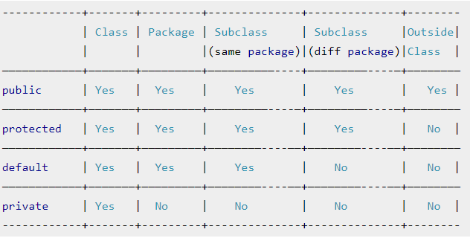
Access Modifiers

Slide 5
Access Modifier: public
 | public
Class | Yes
Fields/ variables | Yes
Methods | Yes
Constructors | Yes

Slide 6
Task:
Create a Project Named: ShapeDemo
Create a new class within the same package named: Circle
Declare two public variables:
radius : double
color : String
Declare a default empty constructor.
Declare another constructor and pass parameters as (double radius, String color)
Create a method named calculateArea() which return the area in datatype double.
For value of PI use= Math.PI

Slide 7
Task:
In the ShapeDemo class Declare an object of Circle class.
Assign values radius = 12 , color =“green” using constructors.
Call the method calculateArea() using the object.
Print the color variable and the area.
Assign value of color =“blue” using the object to the variable color and print it.

Slide 8
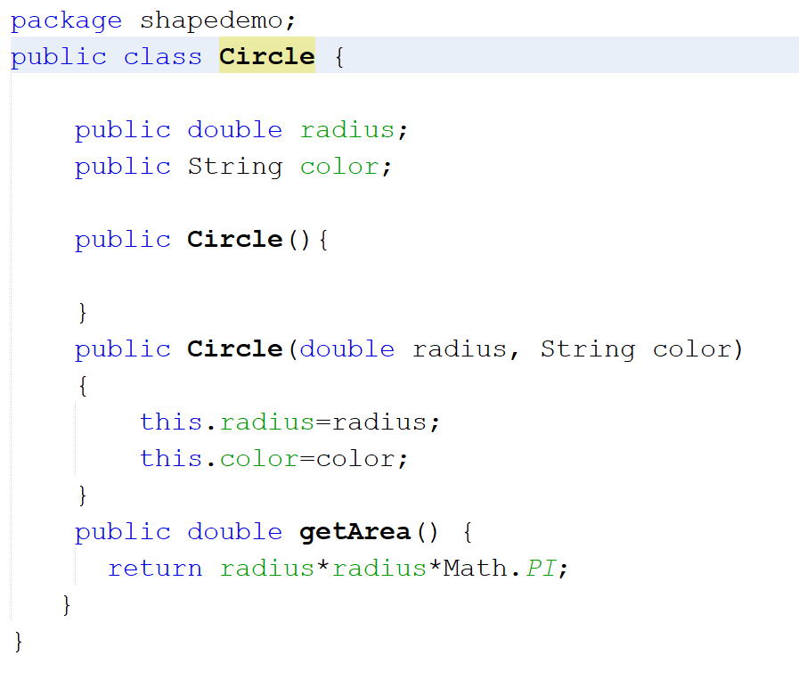

Slide 9
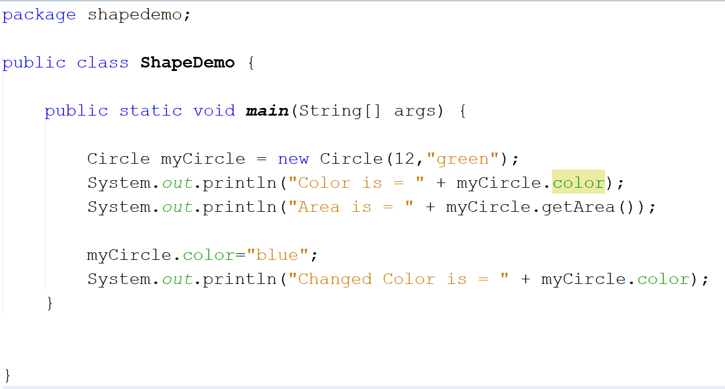

Slide 10
Access Modifier: private
 | private
Class | Mostly NO (can be declared in some cases)
Fields/ variables | Yes
Methods | Yes
Constructors | Yes

Slide 11
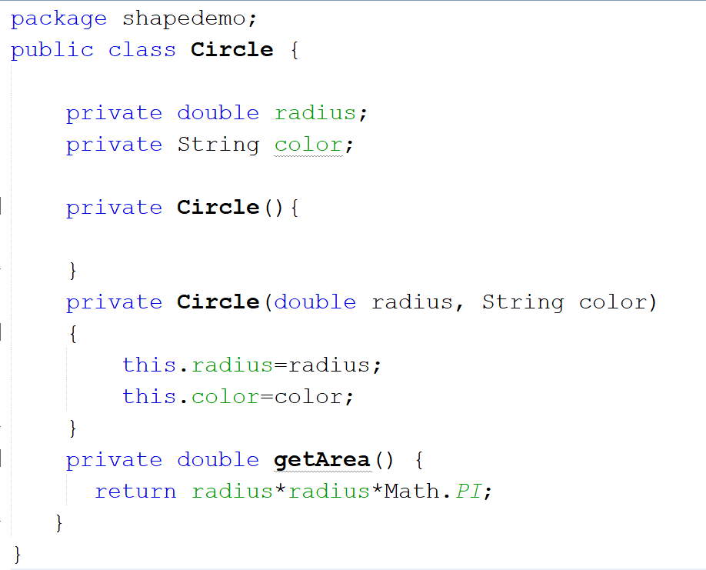
Will Give Error in ShapeDemo
when object is created.
Because Private constructors,
methods and variables
are not accessible.

Slide 12
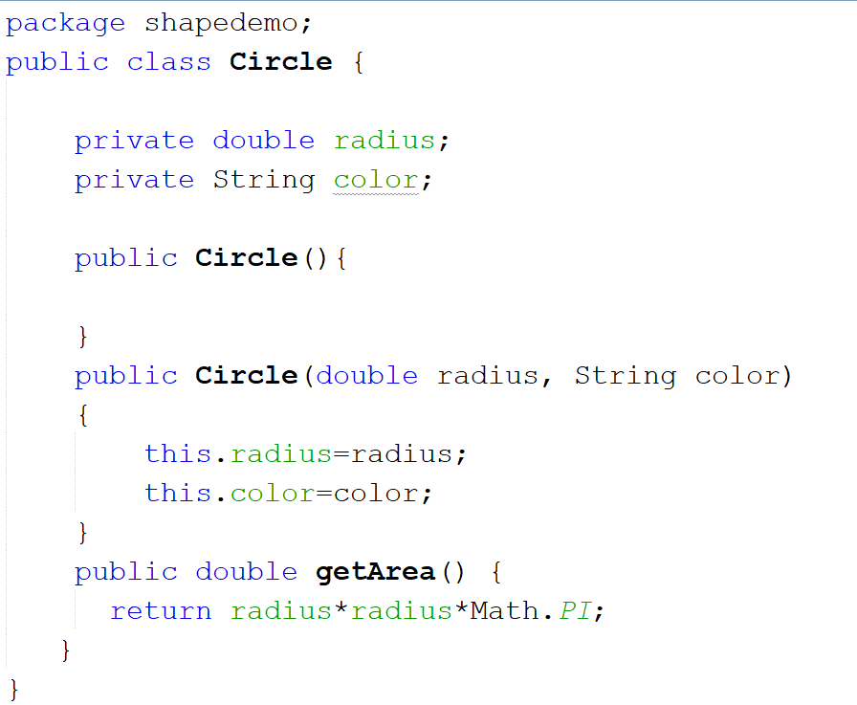

Slide 13
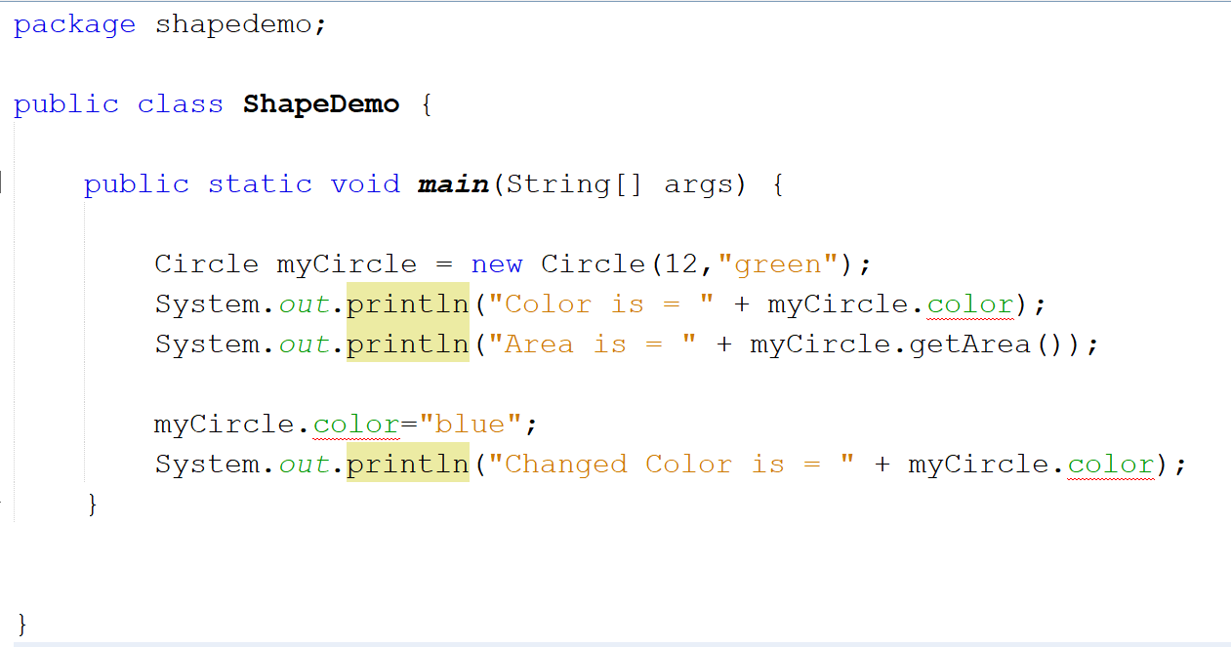
Private variable Color gives error

Slide 14
Solution: Getter and Setter

Slide 15
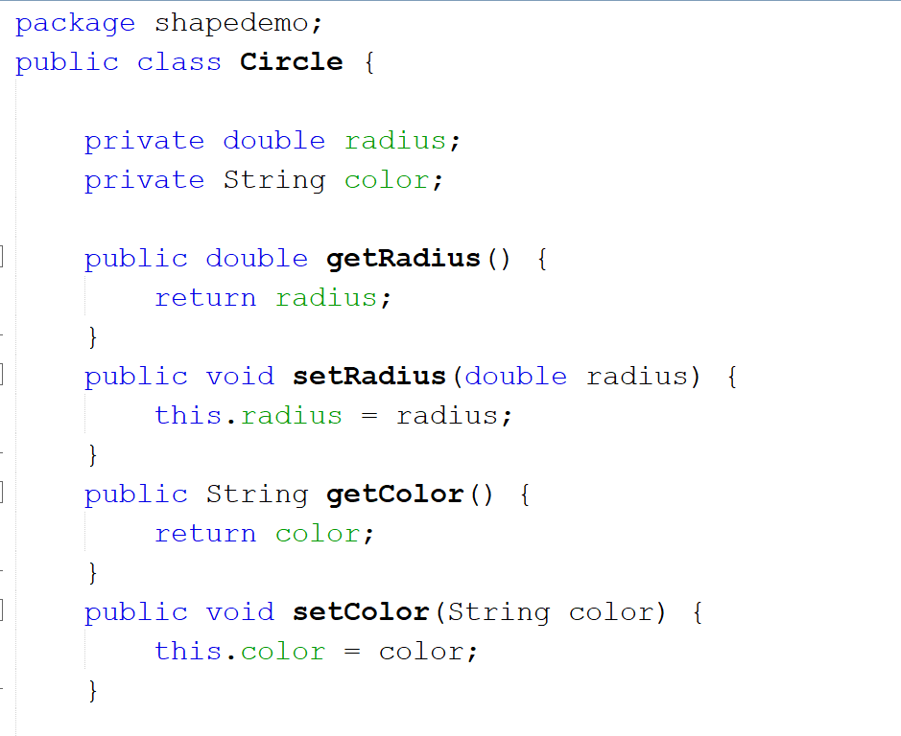

Slide 16
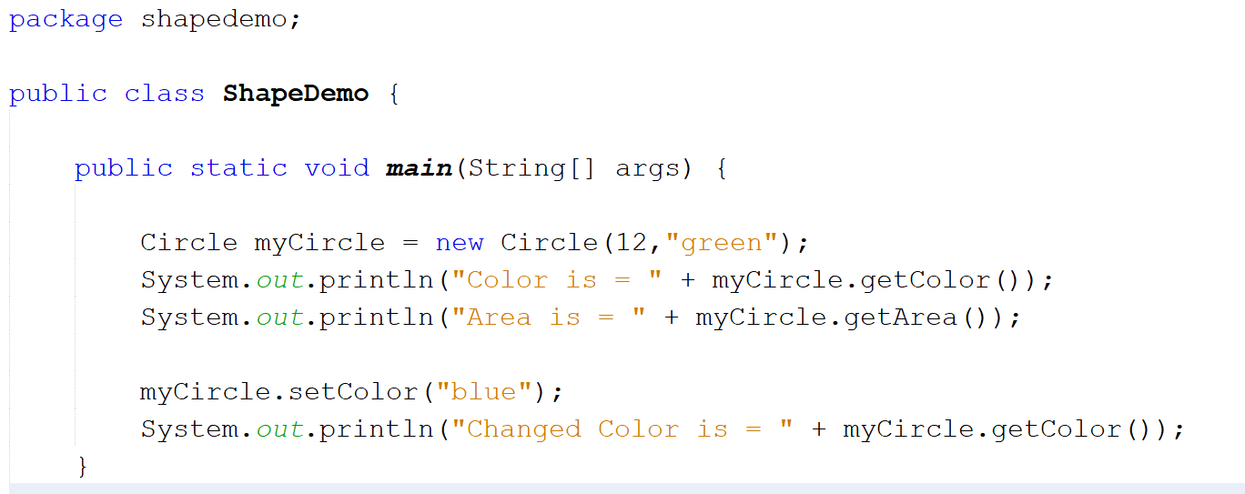

Slide 17
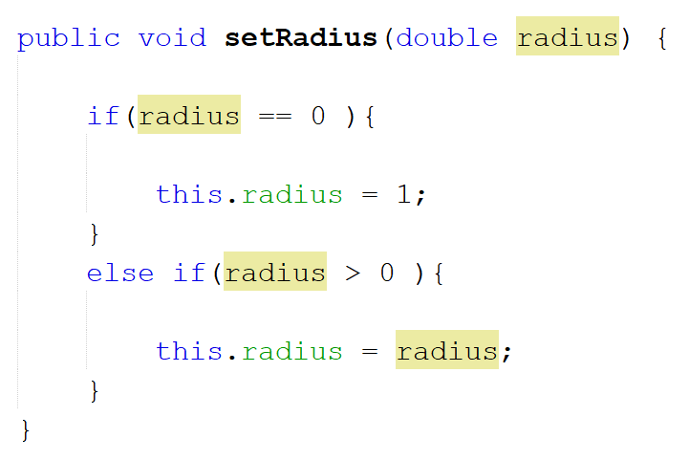

Slide 18
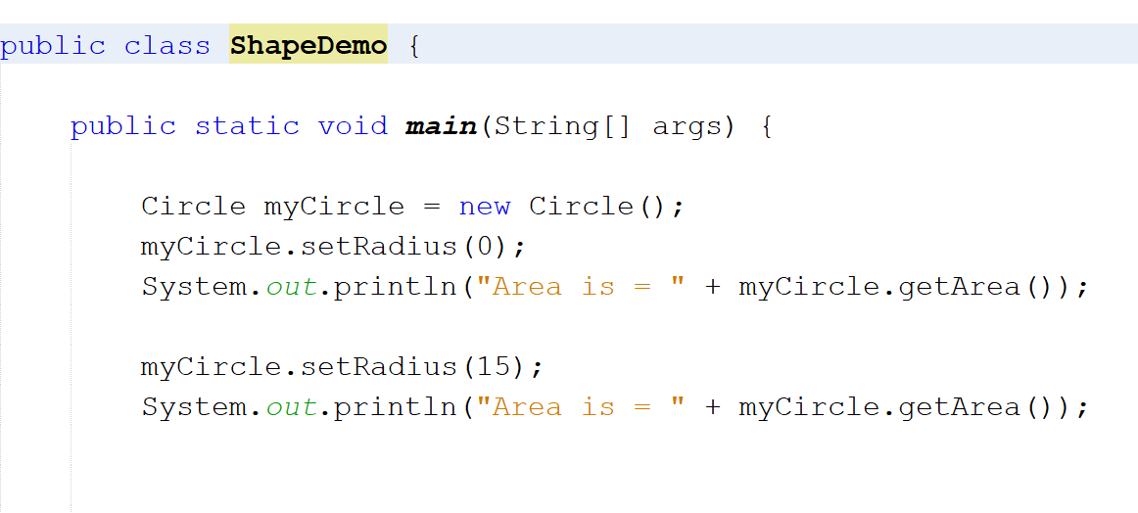

Slide 19
Objects As Parameters in Methods

Slide 20
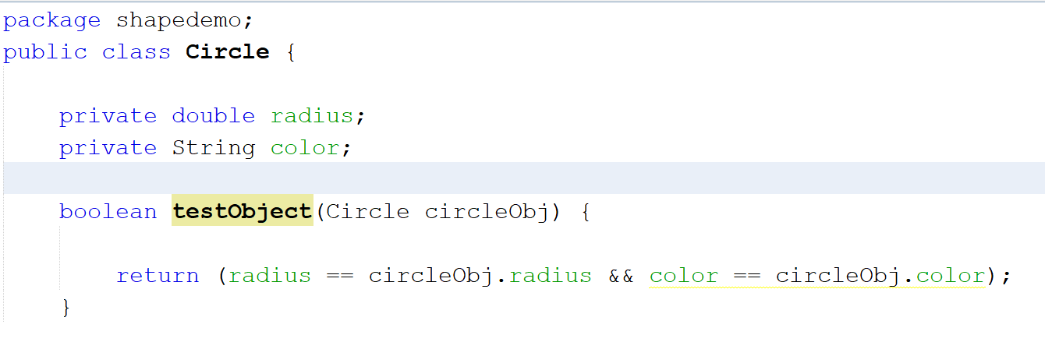

Slide 21
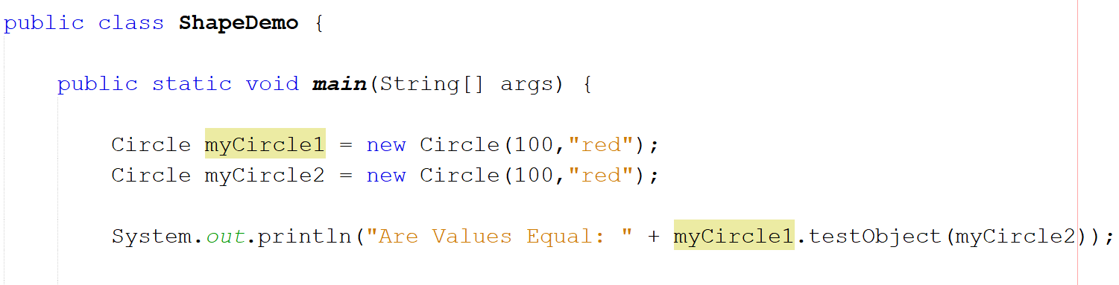

Slide 22
Practice Problem

Slide 23
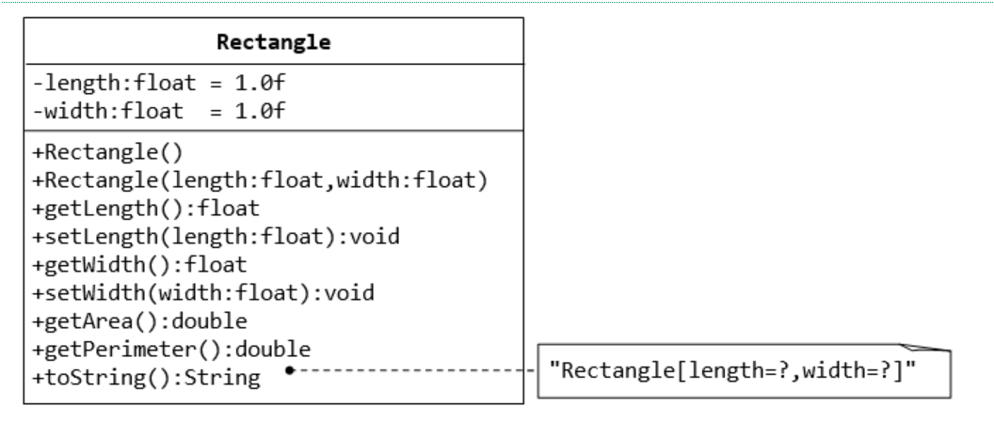
public String toString() {
return “Rectangle[length=" + length + " width=" + width + "]";
}

